Slide 1

Lecture 03
Introduction to the Personal computer- PIII
CT4005NI - Computer Hardware and Software Architectures

Slide 2
Lecture 03’s Objectives
Describe internal components.
Describe the concept of RAID and its type.
Concept of Secondary Storage Devices.
Ports and cables
Input & Output Devices

Slide 3
3.1 Internal Components : Storage Drives
RAID (Redundant Array of Independent Disk)
RAID provides a way to store data across multiple hard disks for redundancy.
To the operating system, RAID appears as one logical disk.
Types: RAID (0-6), RAID 0/1.
Terms Used in RAID
Striping - A method used to write data across multiple drives.
Mirroring - A method of storing duplicate data to a second drive.

Slide 4
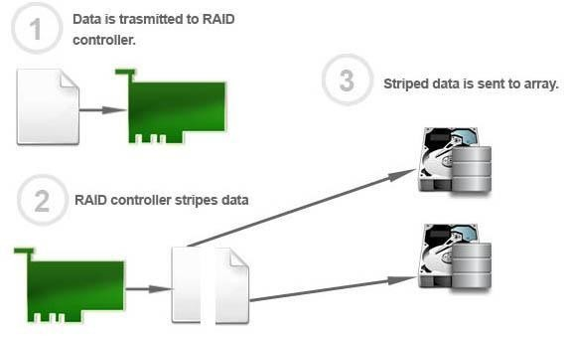
3.1 Storage drives : RAID 0
RAID 0 Array

Slide 5
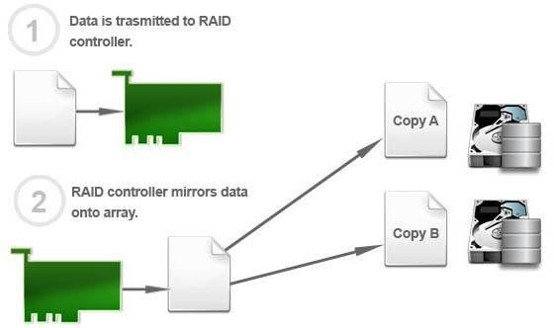
3.1 Storage drives : RAID 1
RAID 1 Array

Slide 6
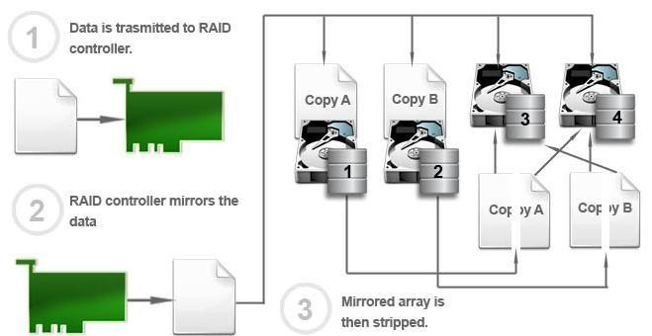
3.1 Storage drives : RAID 10
RAID 10 Array

Slide 7
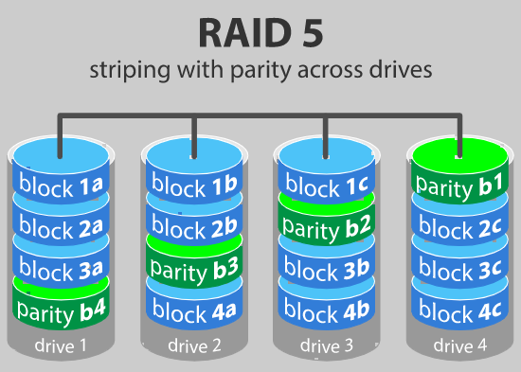
3.1 Storage drives : RAID level 5 – Striping with parity
RAID 5 Array
Requires at least 3 drives but can work with up to 16
Data blocks are striped across the drives
Parity data: computer can recalculate the data of one of the other data blocks, should those data no longer be available
Withstand a single drive failure without losing data or access to data

Slide 8
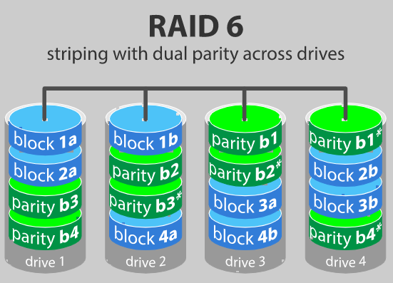
3.1 Storage drives : RAID level 6 – Striping with double parity
RAID 6 Array
Like RAID 5, but the parity data are written to two drives
Requires at least 4 drives and can withstand 2 drive’s failure
simultaneously

Slide 9
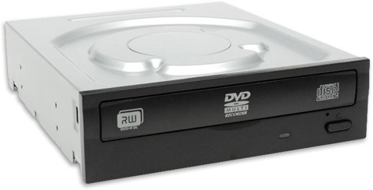
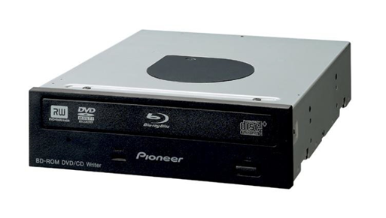
3.2 Storage drives : Optical Drive
●An optical drive is a storage device that uses lasers to read data on the optical media.
●Types: CD (Compact Disc) (700 MB), DVD (Digital versatile Disc) (4.3 OR 8.5 GB),
BD(Blu-ray Disc) (25 OR 50 GB).
●CD, DVD, and BD media can be pre-recorded (read-only), recordable (write once), or re- recordable (read and write multiple times).
Optical Media: DVD-ROM, DVD+/-R, DVD+/-RW (likewise for CD and BD)

Slide 10
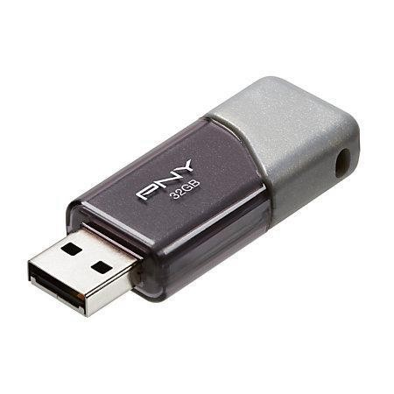
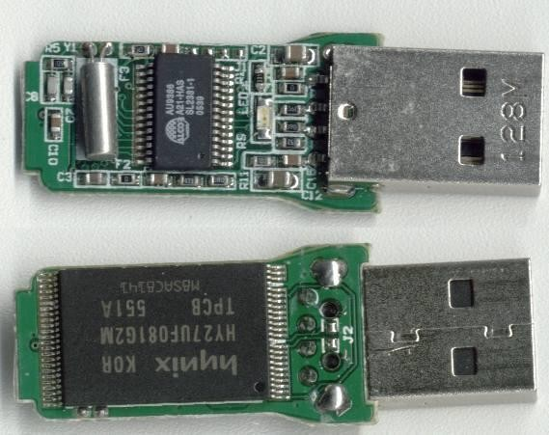
3.3 Storage drives : External Flash Drive
An external flash drive, also known as a thumb drive, is a removable storage device that connects to a USB port.
It uses the same type of non-volatile memory chips as solid state drives and does not require power to maintain the data.

Slide 11
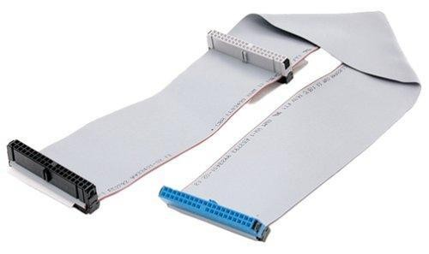
3.4 Internal Components : Drive Interfaces & Cables
3.4.1 Types of Drive Interfaces
Used to interface storage devices to the motherboard.
IDE or PATA drive interface:
40 pins with 40 wires or 80 wires
Speeds: 16MBps, 33MBps, 66MBps up to 133MBps
Master and Slave configuration

Slide 12
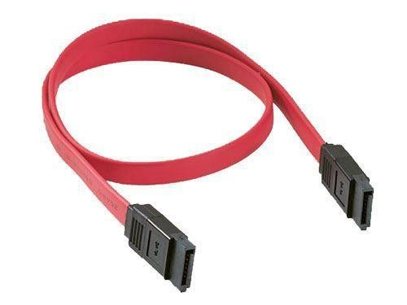
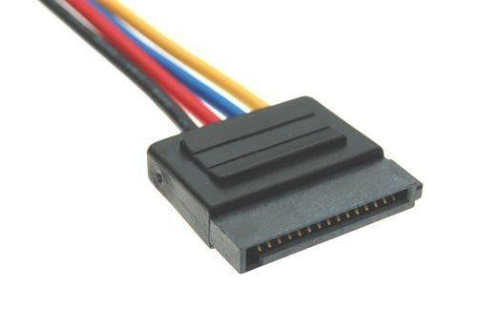
3.4 Internal Components : Drive Interfaces & Cables
SATA drive interface:
7 pin data cable, 15 pin power cable
Distinctive L shaped interface
They are hot pluggable
Speeds: 1.5Gbps, 3Gbps, 6Gbps and 16Gbps
No master and slave configuration
SATA Data Cable
SATA Power Cable

Slide 13
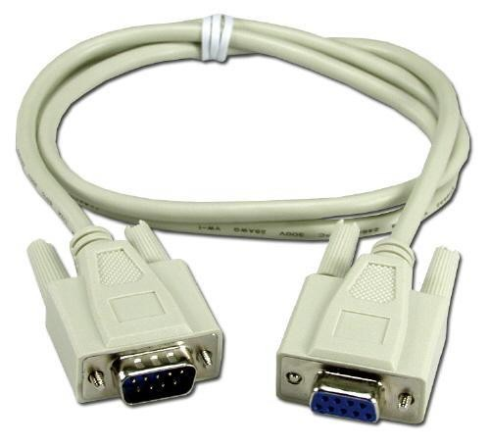
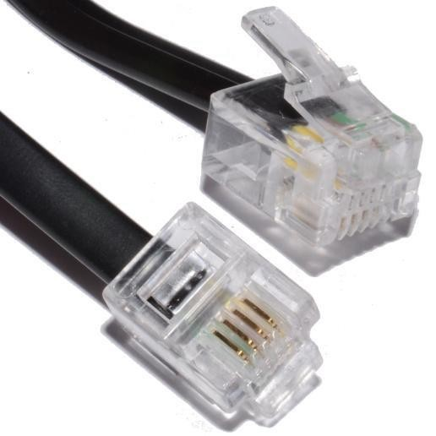
3.5 Ports & Cables
Input/output (I/O) ports on a computer connect peripheral
devices, such as printers, scanners, and portable drives.
Serial (DB-9)
Used to connect a serial device such as a modem and older
peripheral devices.
Modem Ports (RJ11)
In addition to the serial cable used to connect an external modem to a computer, a telephone cable is used to connect a modem to a telephone outlet. This cable uses an RJ-11 connector.

Slide 14
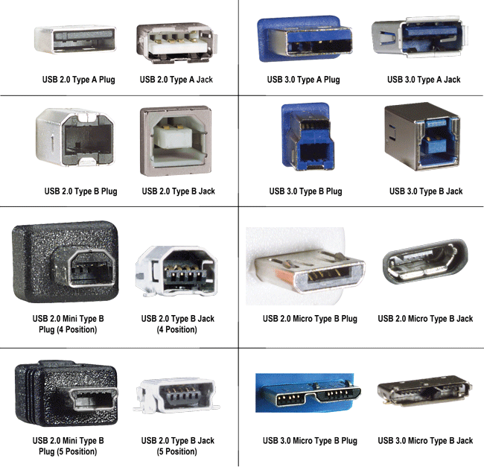
3.5 Ports & Cables
USB Ports and Cables
The Universal Serial Bus (USB) is a standard interface that connects peripheral devices to a computer.
It was originally designed to replace serial and parallel connections.

Slide 15
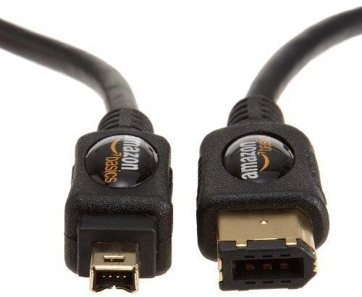
3.5 Ports & Cables
FireWire (IEEE 1394) Ports and Cables
FireWire is a high-speed, hot-swappable interface that connects peripheral devices to a computer.
Data rates can be supported up to supported up to 3.2 Gbps over a 100m distance.

Slide 16
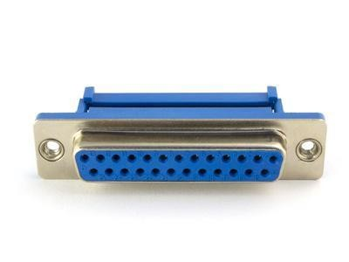
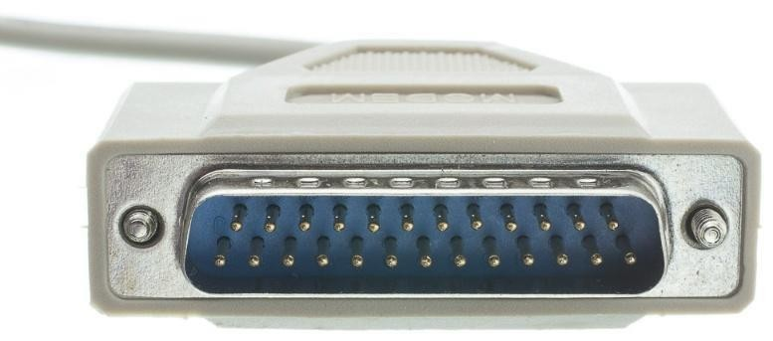
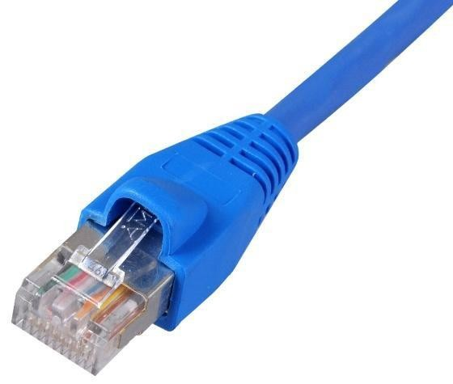
3.5 Ports & Cables
Network Ports and Cables (RJ45)
A network port, also known as an RJ-45 port, connects a computer to a network.
Types: Ethernet-10Mbps, Fast Ethernet- 100Mbps and Gigabit Ethernet-1000Mbps.
Parallel Ports and Cables (DB-25)
Parallel ports can transmit 8 bits of data at one time and is used to connect parallel device like printer.
DB-25 Male Connector
DB-25 Female Connector

Slide 17
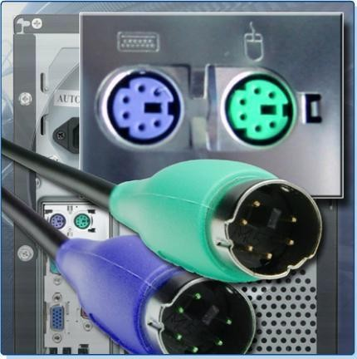
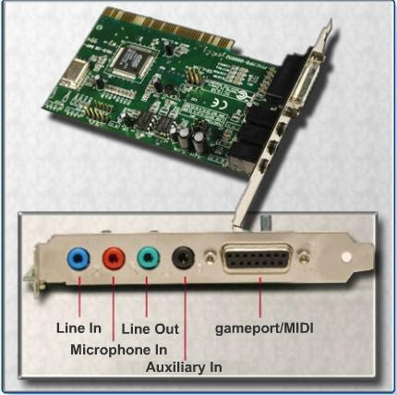
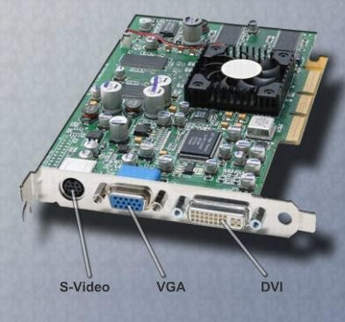
3.5 Ports & Cables
PS/2 Ports
A PS/2 port connects a keyboard or a mouse to a computer.
Audio Ports
An audio port computer.
connects audio devices to the
Video Ports and Connectors
A vide port connects computer.
monitor cable to a

Slide 18
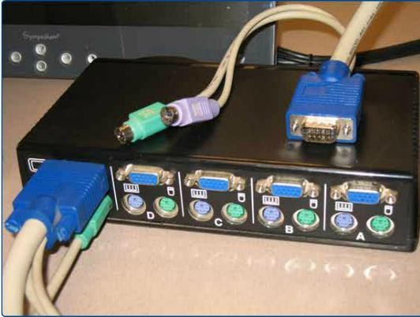
3.6 Input Devices
An input device is used to enter data or instructions into a computer.
Types:
Mouse and keyboard
Digital camera and digital video camera
Biometric authentication device
Touch screen
Scanner
A keyboard, video, mouse (KVM) switch is a hardware device that can be used to control more than one computer using a single keyboard, monitor, and mouse.

Slide 19
3.7 Output devices
An output device is used to present information to the user from a computer.
Types:
Monitors
Projectors
Scanners
Printers
Speakers

Slide 20
3.6 Output Device: Monitor
Electronic device that outputs information in pictorial form.
Types:
Cathode-Ray Tube (CRT)
Liquid Crystal Display (LCD)
Light Emitting Diode (LED)

Slide 21
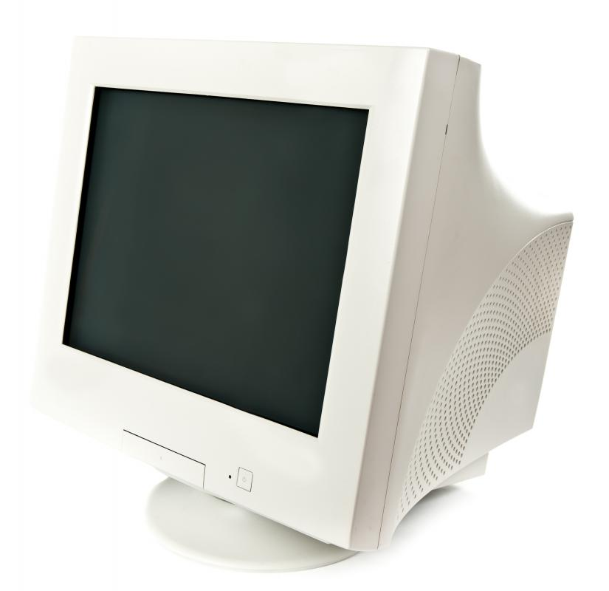
3.6.1 Monitor: Cathode-Ray Tube (CRT)
Vacuum tube comprised of an electron gun at one end and a fluorescent screen at another end
Capable of producing thousands of different colors and a resolution of up to 2048 x 1536 pixels, low refresh rates (approximated 60 Hz)
They emit a very small amount of X-ray radiation
Their illumination levels can strain the eyes and
reduce visual acuity

Slide 22
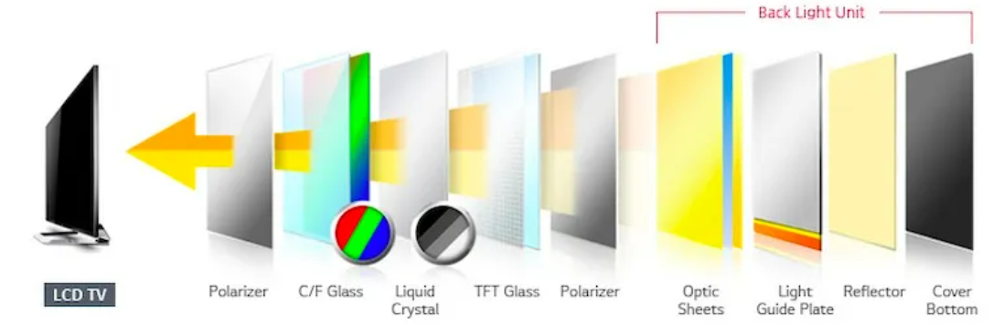
3.6.2 Monitor: Liquid Crystal Display (LCD)
LCD surpassed the picture quality of CRTs
LCD uses the light-modulating characteristics of liquid crystals
They cannot produce light on their own: liquid crystals use a reflector or backlight to generate images in monochrome or color
Low response time and loss of contrast in low and high-temperature environments

Slide 23
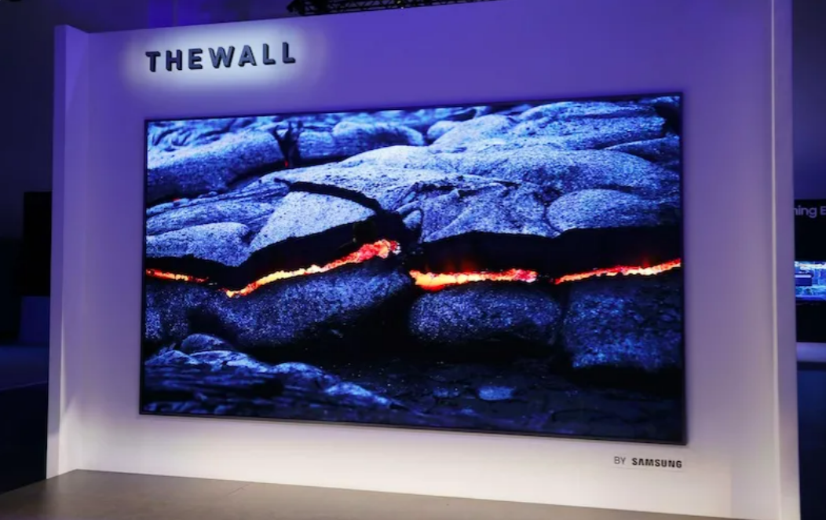
3.6.3 Monitor: Light Emitting Diode (LED)
Latest type of monitors in the market today,
LED display uses light-emitting diodes for backlighting
A light-emitting diode is capable of producing light from electricity
It lasts longer and produces several different colors
Most modern digital displays use organic light-emitting diode (OLED)
OLED consists of an organic compound film that emits light in response to an electric current.

Slide 24

End of Lecture for week 03
Any question ?

